Slide 1
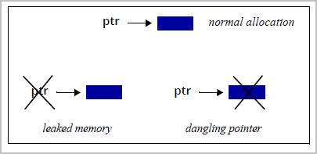
Memory Leaks and Dangling Pointer

Slide 2
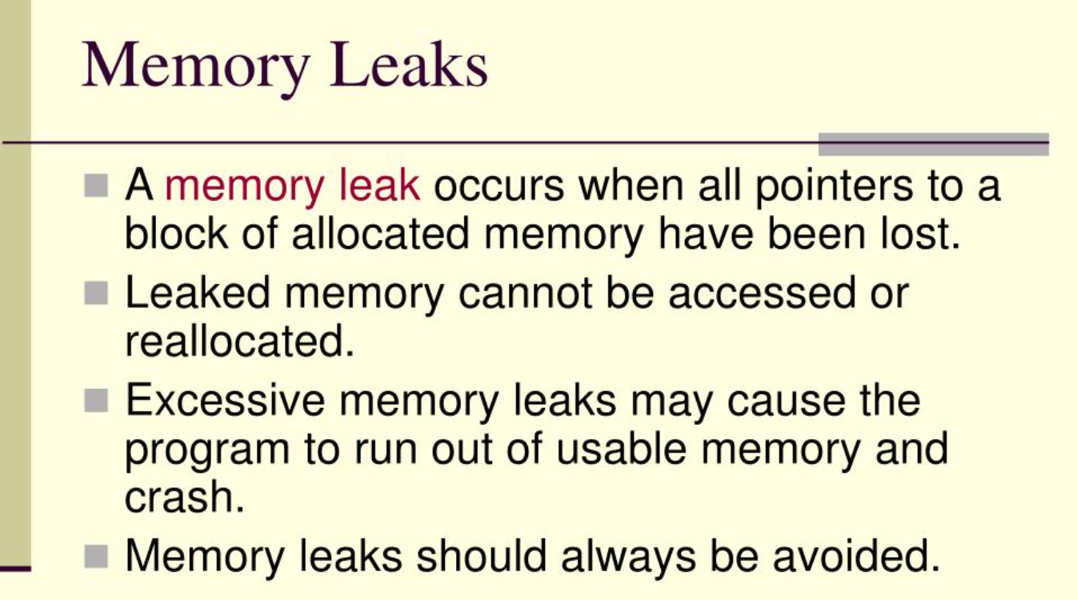

Slide 3
